Slide 1

What is CLT & it’s Importance?
Section 2
Video 2.0

Slide 2
Why Do We Care About Normal Distribution?

Slide 3
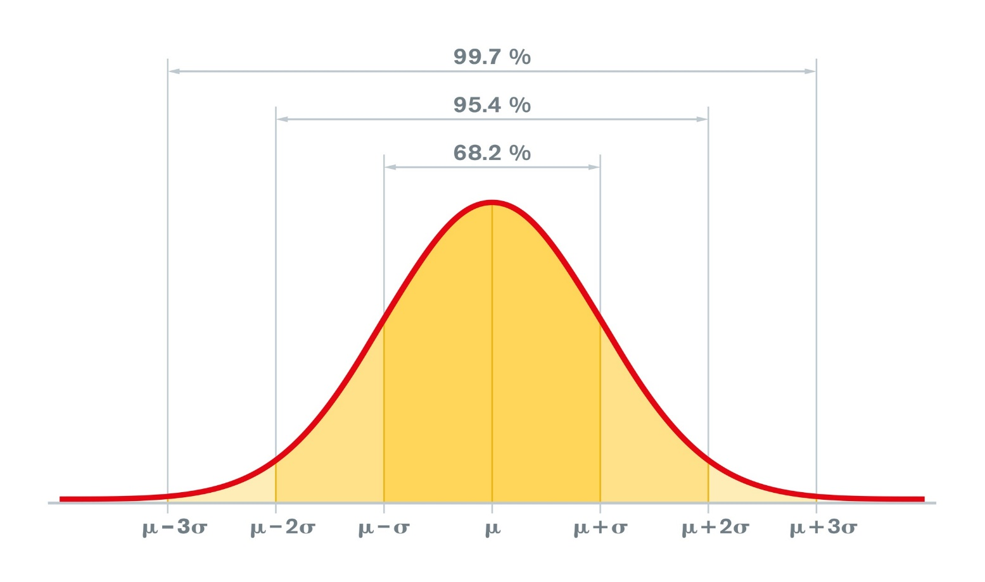
Empirical Rule

Slide 4
Essential of CLT
Next Video

